Slide 1


Slide 2
OUR STORY
Once upon a time, in a world hungry for authentic voices and unfiltered inspiration, there emerged a beacon of creativity that shattered the boundaries of conventional media. This is the story of UncutXtra, where vibrant yellow, bold black, and timeless white converge to create a tapestry of style, lifestyle, and entertainment.

Slide 3
OUR STORY
In the heart of a bustling city, a passionate individual broke free from the constraints of societal norms and provide a platform that celebrated the uncut essence of life. Believing that fashion was a form of self-expression, a vibrant language spoken by individuals unafraid to showcase their unique style.

Slide 4
OUR STORY
Recognized that lifestyle was not a mere existence but a work of art, crafted by personal choices and experiences. And also understood that entertainment had the power to touch hearts and souls, creating lasting memories that resonated with audiences.
Thus, UncutXtra was born.

Slide 5

OUR LOGO
The logo's design reflects the Uncutxtra tribe's connection to nature.
Our logo is proudly displayed on our contents across all our platforms and serving as a testament to our unwavering commitment to our craft and our unique creative identity.

Slide 6

OUR LOGO
Primary logo
This is our main go-to version of the logo, except for limited expectations.
The “UNCUTTRA” is in black: The black lettering represents the depth and mystery of their artistic expressions. It signifies the darkness from which they draw inspiration, the unexplored depths of their souls, and the transformative power of their crafts.
The yellow "X" within the logo represents the tribe's symbol of unity and rebellion. It stands for the crossroads where creativity meets resistance and challenges the status quo. The vibrant yellow colour symbolizes the energy and vitality that radiates from their collective spirit.

Slide 7

OUR LOGO
SECONDARY LOGO
This logo is used interchangeably when we cannot use the primary logo due to maybe the background colour being the same with the logo colour or maybe for any other valuable reasons.

Slide 8
LOGO SIZE/USAGE
All logos mustn’t be smaller than half an inch in length (0.5”) for readability.
The logos should be used on all official Uncutxtra publications, websites and all other contents across the social media platforms. The logo should not be altered, because the logo is a trademark for the brand.

Slide 9
OUR COLOUR
VIBRANT YELLOW
Yellow, the colour of sunshine and possibility, infused each page with a radiant energy. It symbolized UncutXtra's unwavering commitment to positivity and inspiration, encouraging readers to embrace their true selves and chase their dreams unapologetically. Like a burst of sunlight on a cloudy day, yellow brought warmth and optimism to every aspect of the brand.
#F5B41A

Slide 10
OUR COLOUR
BOLD BLACK
Black, the embodiment of elegance and sophistication, served as the anchor of UncutXtra's visual identity. It represented the brand's authority in the world of fashion, lifestyle, and entertainment—a beacon of style and refinement. Black showcased the depth and richness of stories featured within the magazine, grounding them in a sense of timeless allure.
#010101

Slide 11
OUR COLOUR
TIMELESS WHITE
White, pure and pristine, acted as the canvas upon which UncutXtra painted its unfiltered tales. It symbolized transparency and honesty, inviting readers to explore the raw emotions and genuine experiences behind every fashion trend, lifestyle feature, and entertainment piece. White whispered of untold stories, urging readers to delve deeper and uncover the hidden layers within.
#FFFFFF

Slide 12
DIGITAL GUIDELINES
FOR WEBSITE: the website should be upgraded regularly.
FOR SOCIAL MEDIA: 6 Post for every week, 3 videos and 3 graphics and each should not deviate from the social media branding methods.
There are templates for graphics and video, and those templates should be followed for any post that is going on the social media pages.

Slide 13
IMAGE/CONTENT SOURCING GUIDELINES
The images to be posted MUST be very clear and readable
The contents MUST be recent contents and/or videos across the world.
The contents MUST meet be relatable to our brand

Slide 14
BRANDING DON’TS
The brand is an international brand, so avoid posting of only local news or graphics on any of the brand’s social media page or website.
Never make any post without it first passing through some reviews from the team.
Never post any content, outside the content calendar expect on special occasions like birthday, anniversary celeberatons.

Slide 15
OUR FONT
Uncutxtra official fonts are . These fonts are to be used in all our contents. Using this font in all printed material will help to establish a consistent look and feel for all of our communications.

Slide 16

OUR FONT

Slide 17

OUR FONT

Slide 18
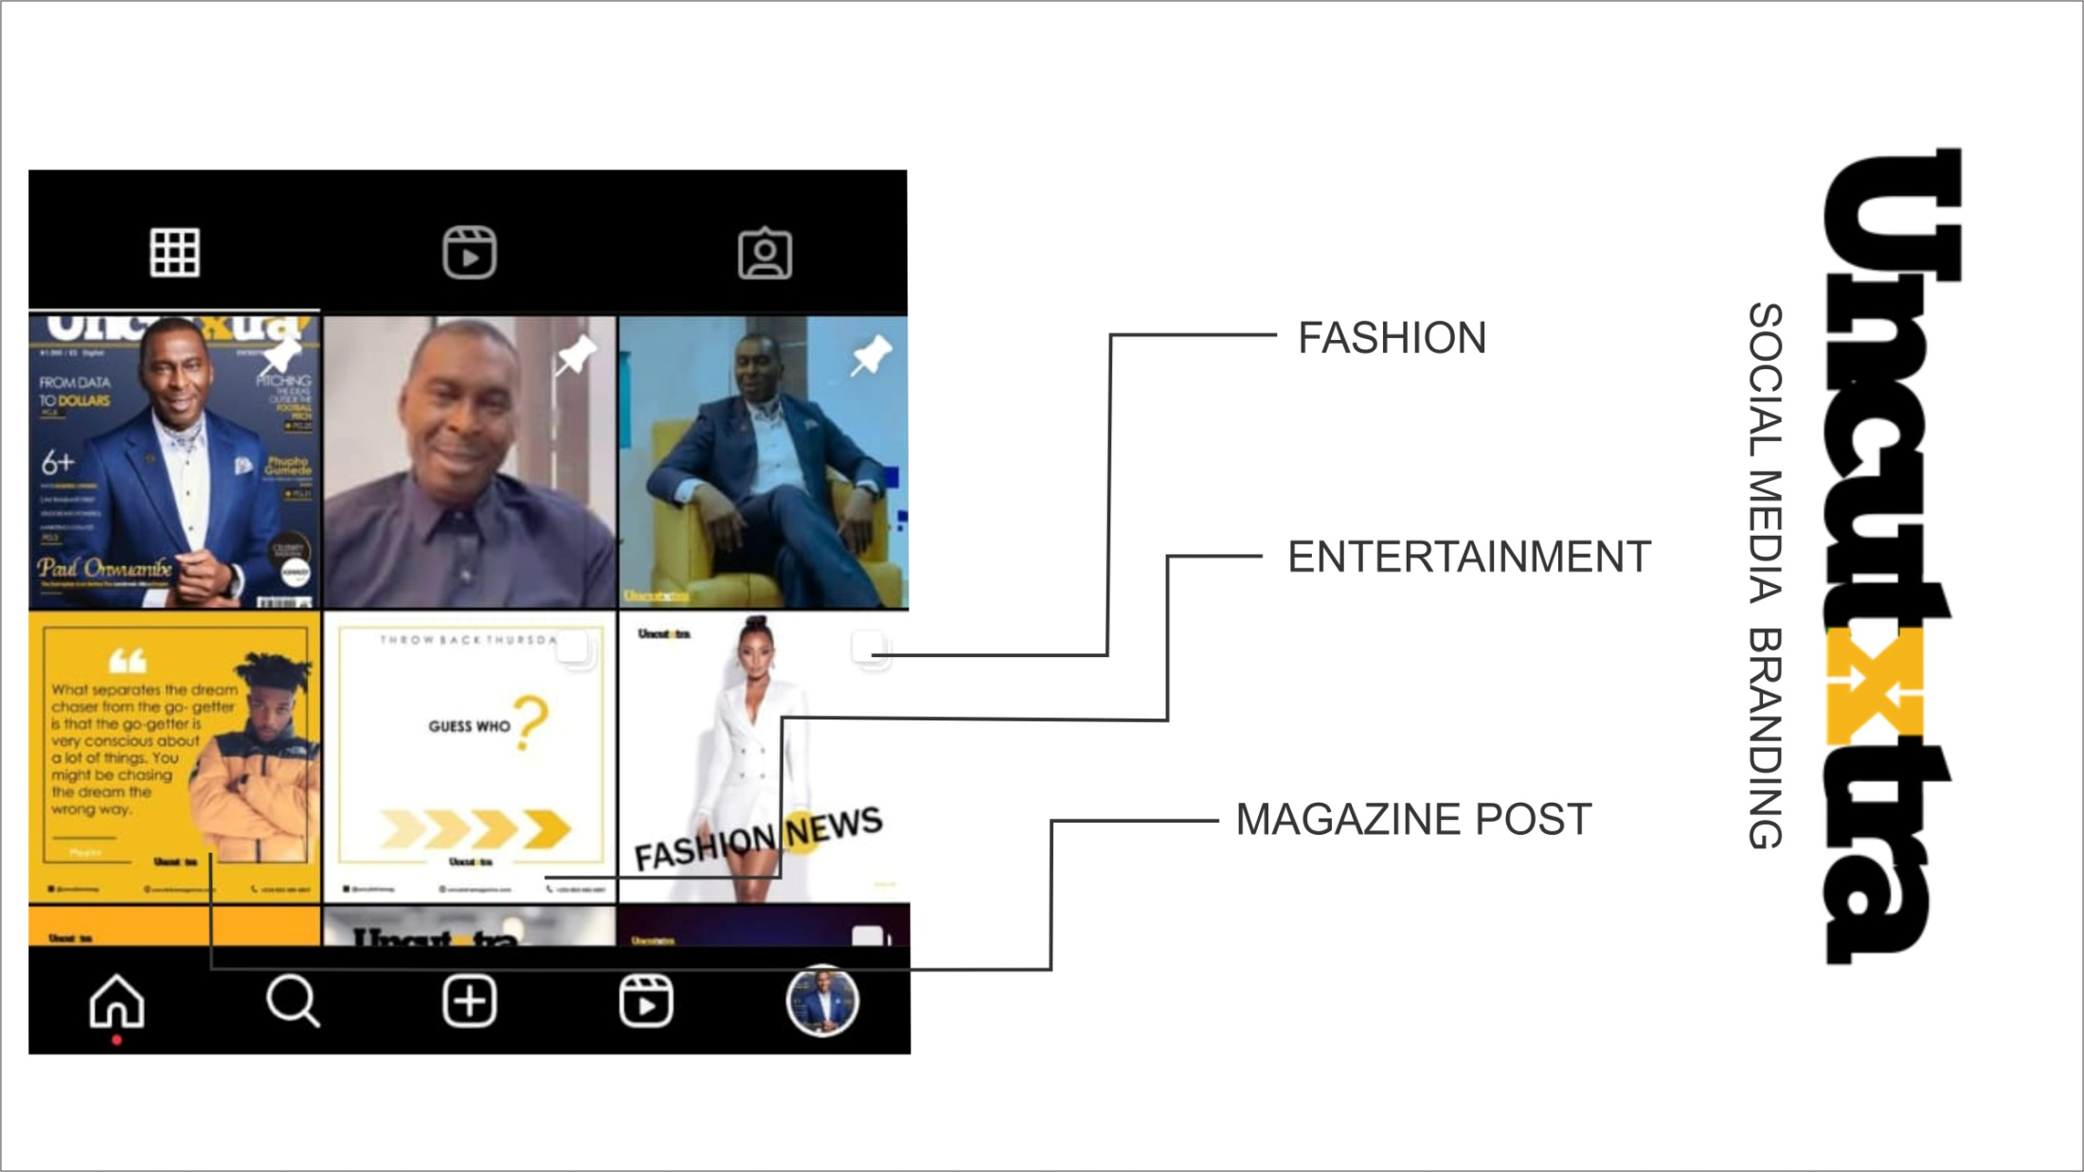
SOCIAL MEDIA BRANDING

